Slide 1

Welcome to
Thurrock School Sport Partnership
AGM 2026/27

Slide 2
Agenda
Introduction & Staff
School Games Website/SGM
2026/27 events & Website
RULES & Code of Conduct
Thurrock SSP School Games Leaders
Medal Table
Netball
Sport Premium Changes
Website
AOB

Slide 3
1) Welcome Back!
Thurrock SSP www.thurrockssp.co.uk
Alexa Joel (School Games Organiser) : joela@wes.swecet.org
07792 187157
SGO Monday, Tuesday & Friday
Maternity cover until January – Andy Dobson dobsona@wes.swecet.org (SGO Wednesday & Friday)

Slide 4
SSP Staff
Lyn Francis – SSP Team
07758 151093
Ellie Grafton – SSP Team

Slide 5

www.yourschoolgames.com
https://www.yourschoolgames.com/register/
Access to: Resources, School Games Mark applications (when opens in the summer term), calendar, blogging, opportunity to win prizes and much more.
Please don’t use this website to enter our events.
Inclusive Health Check – please complete for your school (this needs to be completed to apply for SGM)

Slide 6

School Games Mark 2025/26
Disappointing number of applications:
2 Bronze
4 Silver
6 Gold
9 Platinum
Fantastic to see so many schools achieving the platinum award – upwards trend of awards is great to see.

Slide 7
Review of 2025/26
Disappointing cancellation of Borough Olympics due to extreme heat – those schools affected will only pay £25 for Borough Olympics for this academic year.
Any feedback for other events that needs discussing?

Slide 8
SSP Website, Events & Calendar
www.thurrockssp.co.uk
All information you need is on the SSP website.
Calendar of all our events, CPD, meetings, competitions, and other events.
Rules for competitions
Code of conduct

Slide 9
2026/27
All events will be on Fridays – there are no events that take place on any other days
Sign up in the usual way via the NEW website
You will be sent a confirmation email – these tend to go into junk filters and you will need to speak to your IT department to get access to them.
There is a 'Waiting list' if the event is full, if spaces become available you will be emailed to ask if you want to fill it at the beginning of the week of the event.
Schools will be emailed Monday morning reminding you of entries for the Friday event. You will have until Monday evening to withdraw and then the order of play will be completed.
No parents are permitted at ANY of our events except the swimming gala.

Slide 10
2026/27 – Date changes
SPORTSHALL ATHLETICS DATES
year 5/6 sportshall - BSV
Year 3/4 – BSV
KS1 – Sportshall skills festival at William Edwards School
Borough Olympics group 4 & 5 9th July
KS1 Borough Olympics 2nd July

Slide 11
Rules
Please make sure you check the rules before selecting and then bringing your team.
Resources section of the website will have the rule pack for 26/27 which contains all the rules for all our events – please do not email asking for rules!
If you turn up with the incorrect team you will be unable to win medals and qualify through to represent the SSP at Level 3 if you were to win the competition.
If you wish to withdraw please email me.
As much notice as possible for withdrawals please
£50 fine for non attendance or less than 24 hours notice.
There is no ‘dashboard’ on the SSP website where you can login and see the events you have booked, you will need to make a note of them in a diary when you book them and will also be sent a confirmation email – these emails DO work and will likely go to your junk/spam folder so please check. These emails give you a link to be able to cancel an event.
If you are running late on the date please let us know via text so we can adapt the order of play.
Similarly if you need to withdraw on the day due to staff sickness/issues out of your control please let us know ASAP but you will incur a fine.

Slide 12
Staff Code of Conduct
Recognise the importance of fun and achievement when coaching young players
Understand that most learning is achieved through doing
Appreciate the needs of the players before the needs of the sport
Be a positive role model
Keep winning and losing in perspective – encourage young players to behave with dignity in all circumstances
Respect referees and the decisions they make and ensure that the young players recognise that they must do the same
Provide positive verbal feedback in a constructive and encouraging manner, to all young players, both during coaching sessions and games.
Understand the rules of the events and ensure your team abides by them at all times
Failure to meet the expectations of the code of conduct will result in your being spoken to and warned by the ssp event team, any further incidents we may need to speak to your Headteacher.
Copies of the Code of Conduct are available to download on the website

Slide 13
County Finals – 2026/27
Girls Football 17th November - Billericay Town
Boys Football 24th November – Billericay Town
Basketball date TBC – University of Essex
Tag rugby 3rd February – Southend Rugby Club
Cross Country 24th March – Garons
Sportshall athletics date TBC – Southend
Netball May tbc
Rounders Thorpe Hall – 23rd June
3 tees Colchester – 7th July
Rapid Fire Colchester – 14th July
Dynamo Cricket dates tbc – Billericay
Quad kids year 3/4 30th June Carver Barracks
Quad kids year 5/6 date tbc William De Ferrers

Slide 14
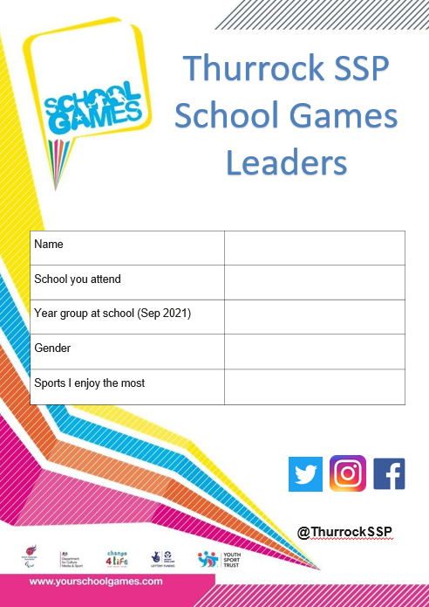
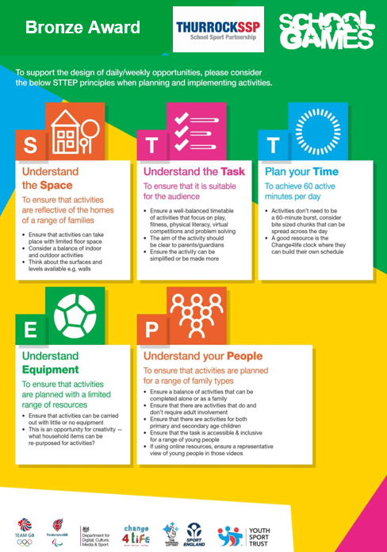
Thurrock SSP School Games Leaders
Sports Leader packs can be emailed to you to print and then children complete and send back to me.
Bronze, Silver & Gold Awards based on volunteering hours/tasks completed
T shirts awarded

Slide 15
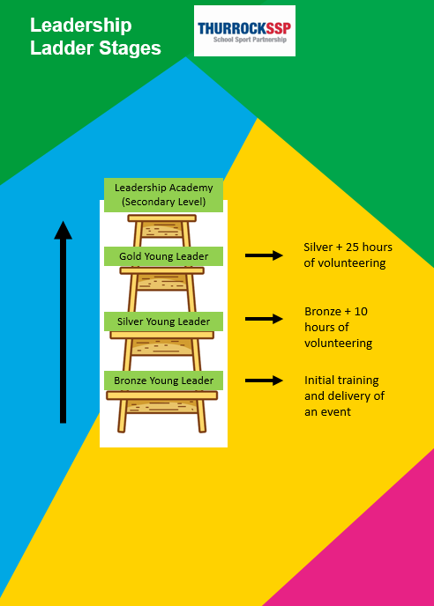

Slide 16
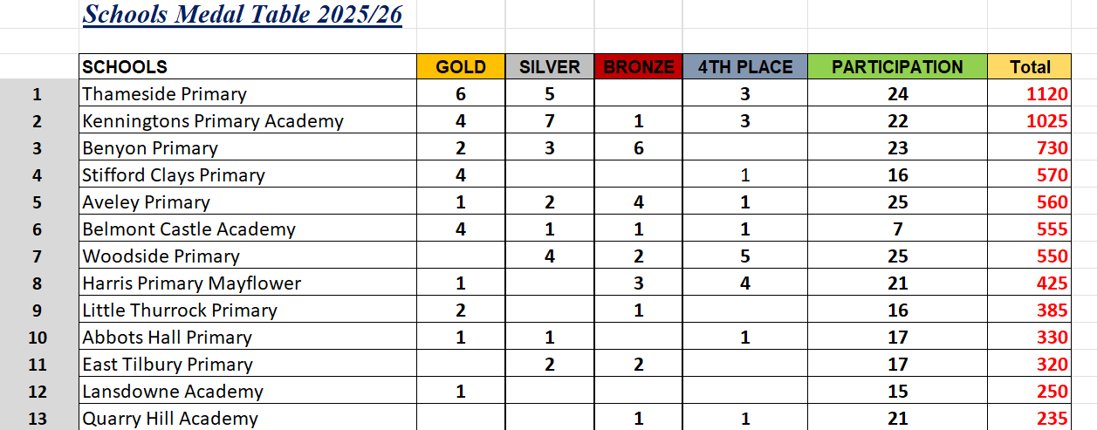
Final Medal Table 2025/26

Slide 17
Medal Table
Points awarded PER school not per team.
Competitive events will award points for 4th – 1st
Festival events will be awarded participation points only (10 points)
Participation (10 points)
4th (additional 10 points)
3rd (25 points)
2nd (50 points)
1st (100 points)

Slide 18
Netball
Rally will be again be at Basildon Sporting Village in April
If you wish to enter the netball league this will be starting after Christmas. All matches must be played by the end of the rally (rally matches can be used for league points if you haven’t managed to arrange a fixture)
Sarah Lou will email out closer to the time asking for schools to sign up if they wish to participate.

Slide 19
Primary PE & Sport Premium
The current PE and Sport Premium model is changing.
During the 2026/27 academic year the Primary PE & Sport Premium model will be phased out, in its place will be a new PE and School Sport Partnerships Network.
SGO network is funded until the end of the academic year 2026/27
Schools will receive a one off transitional payment in the Autumn to be spent across the 2026/27 academic year – there are guidance conditions of the grant.
Procurement for a National Delivery Partner for the new network is beginning with the successful bidder to be expected to be announced in November.
The New network will then get up and running from January, with the National Delivery partner engaging with schools and local partners to understand their needs before delivering support from April.
The direction is becoming clearer, but a few practical questions remain as to what the offer will involve.

Slide 20
AOB
Rules of rounders to be checked as at county rounders they played slightly different rules

Slide 21
Thank you for coming!

