Slide 1






Summer Sports
Leadership 2020
Thurrock SSP School Games Leaders
Name
School you attend
Year group at school (Sep 2023)
Gender
Sports I enjoy the most
@ThurrockSSP

Slide 2


The Thurrock SSP School Games Leadership Ladder
The Sports Leadership ladder allow you to progress through 4 levels of leadership, starting with Bronze, leading to Silver, Gold and then the possibility of being part of the Leadership Academy at Secondary level.
Leadership Academy (Secondary Level)
Gold Young Leader
Silver Young Leader
Bronze Young Leader

Slide 3
Leadership
Ladder Stages
Leadership Academy (Secondary Level)
Gold Young Leader
Silver + 25 hours of volunteering
Silver Young Leader
Bronze + 10 hours of volunteering
Bronze Young Leader
Initial training and delivery of an event

Slide 4
Bronze Award
What is it?
Many of you may have already been involved in some sports leadership within your schools. So now it’s time for you to complete your training to become a Thurrock SSP Bronze School Games Leader.
What do I need to do?
To complete this programme, you will need to:
Complete 6 of the challenges and have them signed off by your teacher.
Plan a competition or personal challenge for your school.
What will I get at the end of this?
Once you have completed the programme and have sent this to your teacher, you will receive a leadership certificate and Bronze School Games Leader T-Shirt and will be on your way to working towards your Silver level.

Slide 5
Bronze Award
In this pack you will find all the information you will need to complete the leadership programme.
Firstly you will need to choose 6 of the leadership activities to complete from the 12 examples we have given you. Any work completed should be added to your pack and returned to your school as evidence. This can be as a paper or word document, or a photograph as evidence.
Don’t forget to get a witness to sign that you have completed the 6 tasks you chose.
Remember, be creative and make it FUN!

Slide 6
Bronze Award
Sports Leaders Activities
(Choose 6 of the following 12 to complete)
Design a trick shot
Design a poster
Can you challenge the people in your school to attempt a trick shot
Design a poster to encourage others to get active and hit their 60 active minute’s target
Fitbit friend challenge
Create a game to play
Challenge someone to a fitbit challenge.
How many steps, how many calories burnt?
Think of a game you could play with others either virtually or face to face.
How do you play the game?
Dance
School Games Values
Create a dance or sequence of moves, using lively music for others to learn and perform
Give an example of how the 6 School Games Values may be shown in sport.

Slide 7
Bronze Award
Design a PE or Sport Kit
Create a recording sheet
Design a suitable kit for everyone to use as either their school PE kit or for a sports event.
Create a way to record physical activity amongst your friends or family. What are you recording, how do you record it?
Challenge
Survey
Design a simple challenge to complete every day for a week. Has the challenge improved the desired skill or increased fitness levels?
Creative a sports survey to find out more about what new sports people in your school would like to try
Club
Plan an activity that you can deliver to some of the younger children at your school.
What is the purpose of the club?
Who is it for? Share the plan with your teacher to see if you can deliver it.
Multi-skills challenge
Deliver a carousel of 4 different skill based activities.
What are the activities? How do you explain/ show them what to do?

Slide 8
Bronze Award
Task List – Have I??
Answered ‘Developing your Leadership skills’ page
The 6 tasks I completed were: | Witness name and signature
Completed 6 of the 12 leaders activities
Planned a house team competition to deliver at school
Send in my completed pack, with evidence to my PE teacher
If you have any questions then please ask your parents to email
joela@wes.swecet.org
We would love to see how you’re getting along, why not get your parents to share your progress through social media. @ThurrockSSP is who they need to tag in.

Slide 9
Bronze Award
Developing your leadership skills
The skills and behaviours that a leader must show are:
Communication
Self-Belief
Team work
Self-Management
Problem solving
Which of these skills do you think you have to use most often as a leader?
Which of the list above do you think are your strengths?
Can you give an example when you have used one of the above?

Slide 10
Bronze Award
For every activity or event to take place and be safe, it must give everyone ‘SMILES’
Safe
Do the participants feel physical and emotionally safe
Maximum participation
Participants are fully involved in all of the activities all of the time.
Inclusive
Activities are designed to suit all participants’ needs and abilities.
Learning
Participants develop new skills or knowledge
Enjoyment
- Participants’ interests and motivation are catered for.
Does the activity achieve SMILES?
Make the Change
STEP
In
Try it out

Slide 11
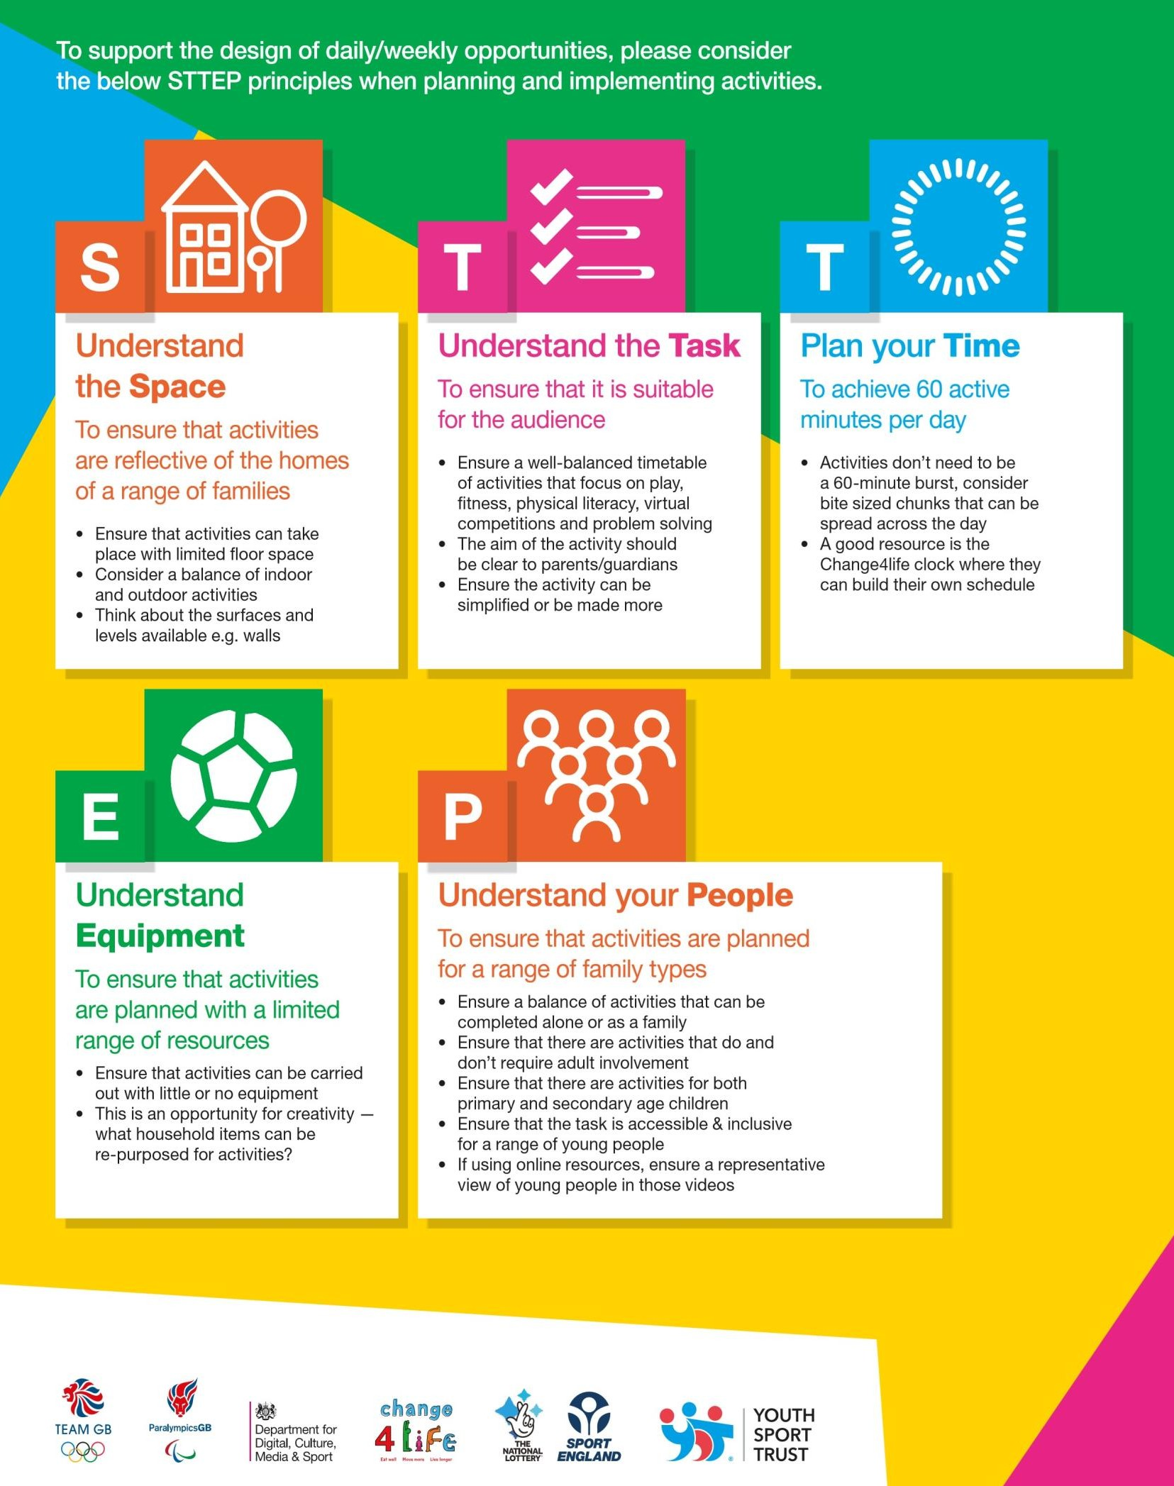
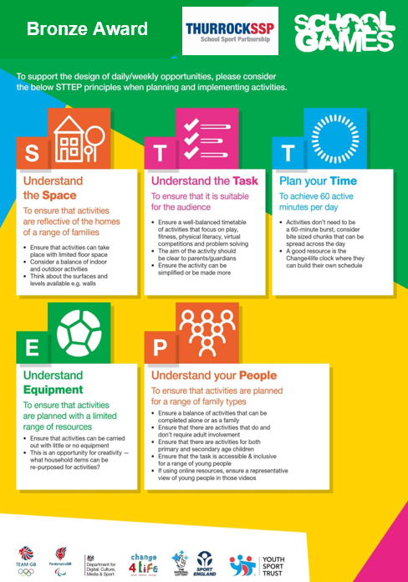
Bronze Award

Slide 12
Event Plan
Bronze Award
Planning a house team competition in school
We would like you to plan a competition that you could deliver in school. This competition does not have to be delivered to complete this leadership pack, but we would like to see how you plan to deliver one.
You can choose the sport and format of the event that you would like to deliver, but remember every house team must be represented and have a fair chance.
What do I need to consider?
The sport and the format of how it will run
How many house teams are at my school
How many people can take part
What equipment will I need
Where and when will it run
How do I determine a winner
S.T.T.E.P – What may need changing during the event
S.M.I.L.E.S

Slide 13
Bronze Award
Doing a risk assessment as part of your planning help keep everyone safe.
Playing area
  It is clean and free from obstacles
  There is enough space for activity
  Spectators and player can move and watch
  Weather, temperature and noise are fine
Equipment
  It is appropriate for the participants
  It is in good condition
  It is set up (taken down) correctly
  It is stored safely during and after play
Participants
  Are wearing appropriate footwear and kit
  Have removed jewellery or accessories
  Understand the rules and safety procedures
  Have no health reasons for not taking part
Organisers
  Know the safety procedures
  Know where to find First Aid provision
  Report any incidents to school staff

Slide 14
Bronze Award
Competition format | Equipment | Pros | Cons | Adaptations
Knockout | Competitors are knocked out if they lose. Winner progress to the next round. | Quick way to identify a winner Competitors learn to deal with pressure | Lack of playing time for competitors who are knocked out. Not everyone will get to play everyone | Have a round robin stage before the knockout stage
Round Robin | All participants play each other. The winner has the best score at the end. | Maximum participation Creates more opportunities for success | Takes a long time Competitors may be waiting around for their turn. | Have smaller groups so reduce waiting time.
Personal challenge | Competitors participate as individuals and the aim is to improve with own performance | Suits competitors who are motivated by personal best Builds confidence and skills | Need competitors to be self- motivated May reduce opportunities to build social skills | Use personal challenge to help set the initial raking
Ladder or pyramid | Competitors are ranked and play others at the same level | Competitors play others of similar standard Competitors can see their progress | Needs enough competitors of similar abilities Competitors may disagree with their abilities. | Use personal challenge to help set ranking at first

Slide 15
Event Plan
Title
Work Space
Equipment needed
S.T.T.E.P
Space
Task Time
Equipment People

Slide 16
Bronze Award
Reviewing my Leadership skills
How did you find the 6 leadership activities?
What strengths do you feel you showed during your planning and delivering of the leadership activities?
What part of the leadership programme did you find the hardest and why?
Would you like to further your leadership skills through any of the following; Leadership Academy, Supporting a primary school event, running a sports cub in your school? – Why?

Slide 17
Volunteering
Hours – Working towards Silver/Gold
Volunteering hours can be completed in a number of different ways such as:
Helping in a sports club or with a sports team at your school
Outside of school in a sports club, team, or event such as parkrun
Assisting your school at an SSP competition or event as a team manager/helper
Volunteering hours must be logged and signed off by your teacher, or if this is outside of school then your parent, or event organiser. There is a volunteering hours log at the back of your pack.

Slide 18
Date & Time | Event & Venue | Task/Responsibility | Hours Volunteered | Signed

Slide 19
Date & Time | Event & Venue | Task/Responsibility | Hours Volunteered | Signed

Slide 20
Date & Time | Event & Venue | Task/Responsibility | Hours Volunteered | Signed

Slide 21
Date & Time | Event & Venue | Task/Responsibility | Hours Volunteered | Signed

